Slide 1
NeoWordNet
Brian Loyal
Capturing the English Language in Neo4j with R

Slide 2

Notes:
This is George Miller, director of such films as Mad Max, Babe, and Happy Feet. He’s the 2nd most important George Miller of the 20th Century.

Slide 3
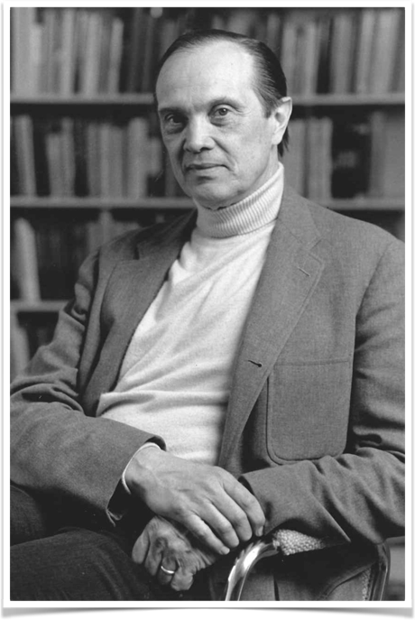
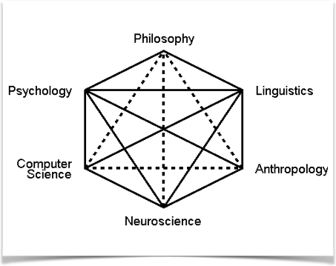


George Armitage Miller
Notes:
This is the most important one. George Armitage Miller was born in 1920 to a single mother in West Virginia. He served in the Army during WW2, developing voice communication systems, and then went on to teach psychology at MIT, Harvard, and Princeton. Miller emerged at a time when Behaviorism was the dominant school of thought in American psychology. Behaviorism, as described by thinkers like Ivan Pavlov and B.F. Skinner, tried to bring scientific rigor to psychology by focusing on what could be observed: Inputs (stimulus) and outputs (response). Everything else happened in the black box of “the mind”. The trouble with this, as Noam Chomsky once said, is that “defining psychology as the science of behavior was like defining physics as the science of meter reading” – you’re sort of missing the point.
Miller rejected this approach, instead bringing together emerging fields like linguistics, computer science, and neuroscience to try to model memory, information processing, and other aspects of the mind. He called this new field “Cognitive Science”, and it is the dominant school of thought in psychology today.
A good example of this is his best known work, “The Magical Number Seven, Plus or Minus Two”. Here, he determined that people typically remember things in “chunks” of approximately seven things. This holds true regardless of the number of bits of information encoded in the things (e.g. “1” vs “Petunia”), as long as the subject was familiar with them.

Slide 4
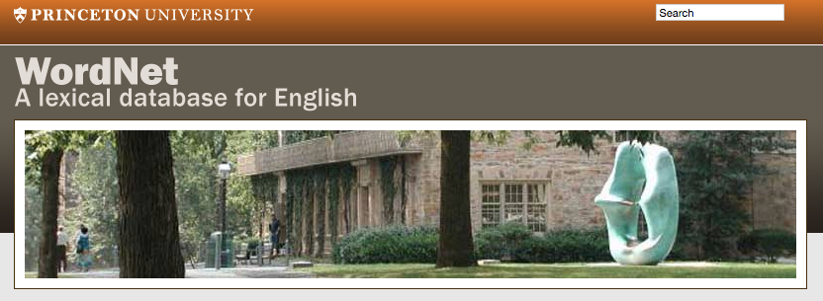
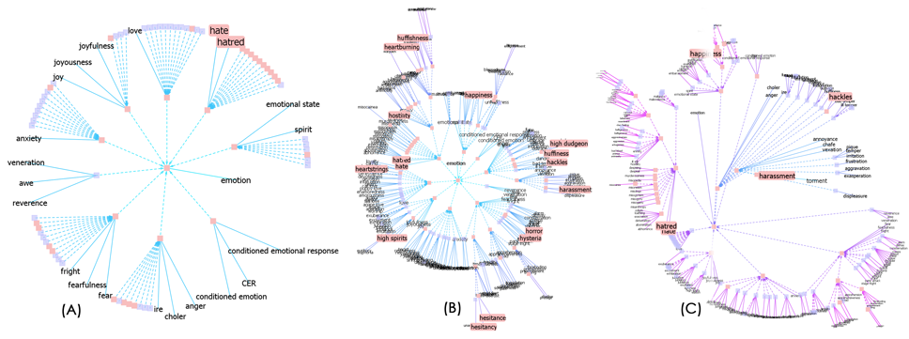
Notes:
Miller’s work was limited by the technology of the day. How do you test theories about language logic without a computer powerful enough to represent it? So, in 1985 he published the first version of WordNet, a lexical database of the English language. WordNet resembles a computer-accessible dictionary. However, while a dictionary is organized alphabetically, WordNet is organized by the underlying meaning of words.

Slide 5

Notes:
For example, everyone knows what a word is.

Slide 6
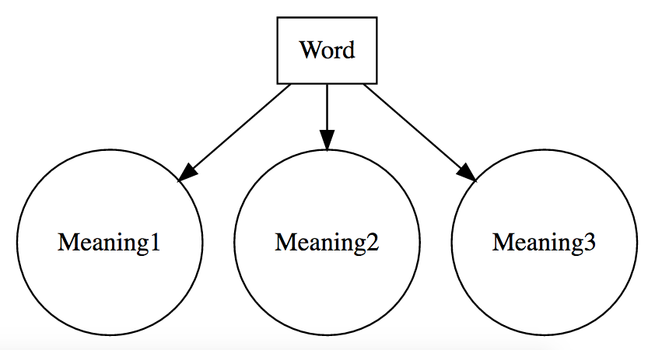
Notes:
A given word might have multiple meanings, depending on the part of speech and other factors.

Slide 7
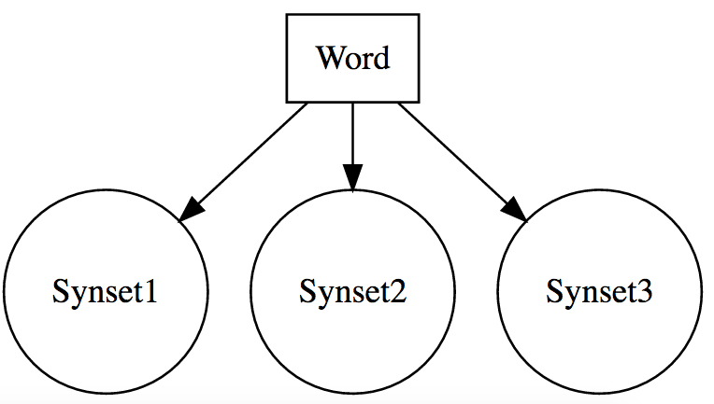
Notes:
Miller called each of these possible meanings a “synset”, short for synonym set.

Slide 8
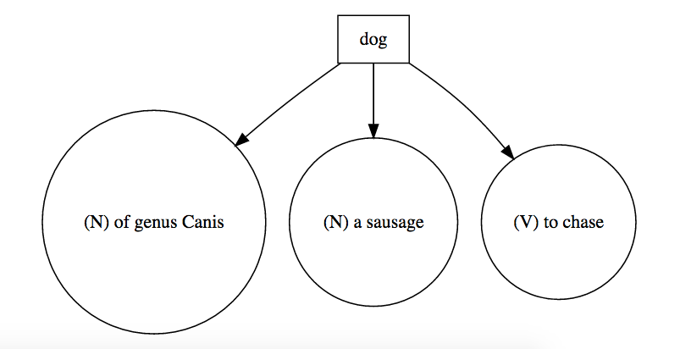
Notes:
For example, the word “dog” could mean multiple things depending on the context

Slide 9
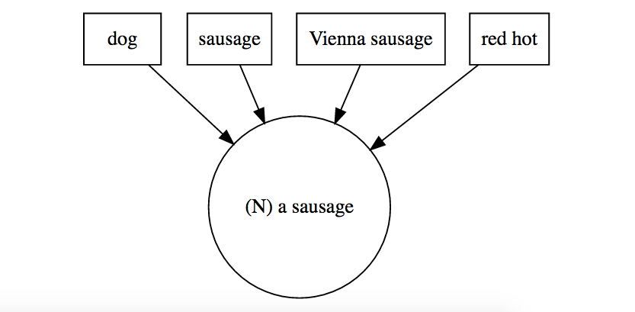
Notes:
Each synset can have multiple words associated to it. In this way, it’s like a thesaurus – if you started with a word, you can link through the associated synset to find other, synonymous words

Slide 10
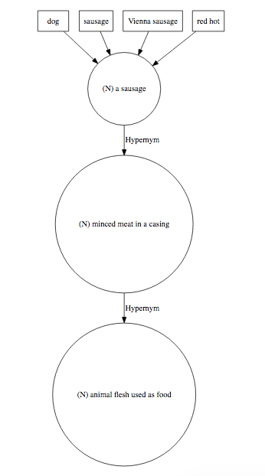
Notes:
The real power of WordNet, however, comes in the way it defines the relationships not only between words and synsets, but also between multiple synsets. In this example, the synset for “A sausage” has a hypernym (class-instance relationship) with the synset “minced meat in a casing”. This in term also has a hypernym: “animal flesh used as food”, and so on. WordNet includes many different types of synset-synset relationships, including hypernym/hyponym (class/instance), meronym/hyponym (whole/part) and others.

Slide 11
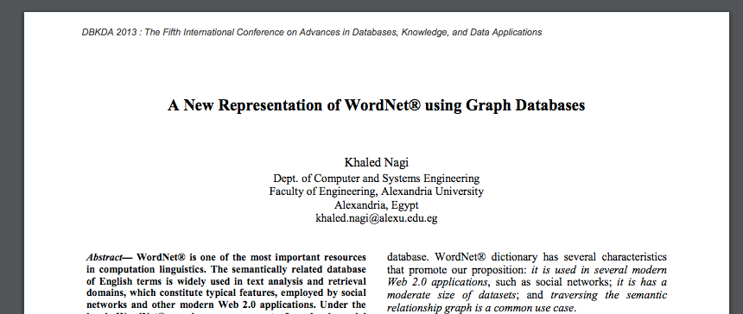
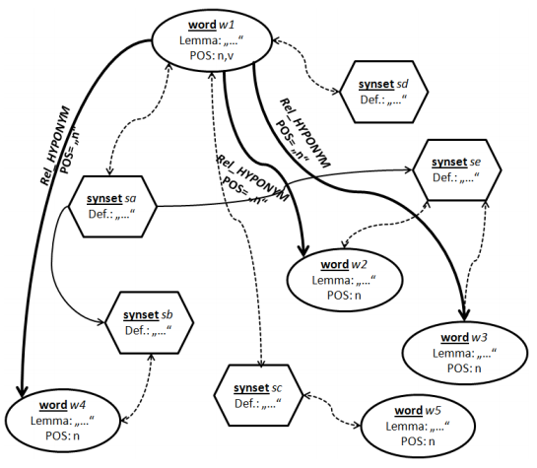
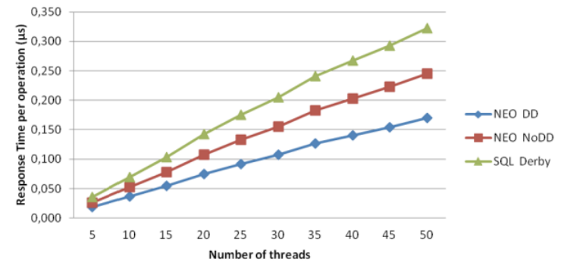
Notes:
I got interested in WordNet while researching ways to compare the similarities between items on a menu. For example, does “spicy” mean the same thing as ”hot”? One resource caught my eye – A paper from Khaled Nagi at Alexandria University describing his implementation of WordNet in Neo4j. A graph database like Neo4j is a natural fit for WordNet and provides better query performance than relational or other NoSQL databases.

Slide 12
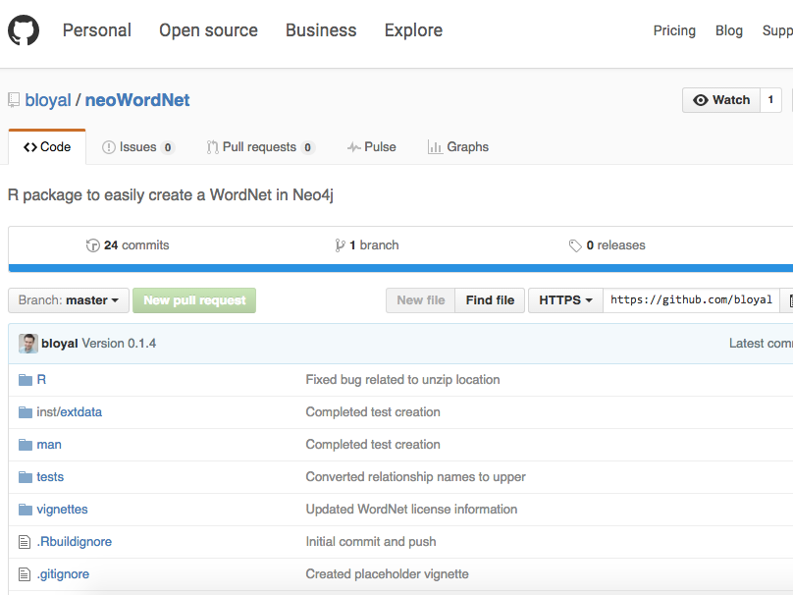
Notes:
Although there are some R packages for interfacing with the standard WordNet database provided by Princeton, there weren’t any for implementing it in Neo4j. So, I made one.
The neoWordNet package (available at https://github.com/bloyal/neoWordNet), downloads the WordNet database files (https://wordnet.princeton.edu/wordnet/download/current-version/), and systematically creates synset nodes, word nodes, and the edges between them in Neo4j. The resulting stand-alone graph database can be explored using the Neo4j web UI or APIs.
The RNeo4j package (https://github.com/nicolewhite/RNeo4j), by Nicole White, was a huge help with this. Definitely required reading if your’re planning to do any Neo4j work in R.
Recently, I installed Neo4j and R/Rstudio on an AWS ec2 instance to improve the build process. Although this does speed up the graph contruction time, the biggest advantage is not having to run my (old, unstable) computer overnight – I let a server in Oregon take care of it instead!

Slide 13
Lessons Learned
Don’t be afraid of DevOps
Notes:
Some lessons learned:
- Even if you’re not a full-stack Java developer, there are some simple things anyone can do to improve their coding workflow. neoWordNet was my first experience with building an R package using the devtools (https://cran.r-project.org/web/packages/devtools/index.html) package, which makes it very easy to leverage things like version control, code documentation, and automated testing.

Slide 14
Lessons Learned
Don’t be afraid of DevOps
“The Cloud”TM is your friend
Notes:
Some lessons learned:
- It’s actually really easy to get started with AWS. It’s not just for major corporations – anyone can spin up a small ec2 instance and use it to develop and share code. By doing this, you can focus on the fun stuff (coding) and leave all of the fancy server maintenance to the pros.

Slide 15
Lessons Learned
Don’t be afraid of DevOps
“The Cloud”TM is your friend
Networks are fun
Notes:
Some lessons learned:
-Some of the coolest projects exist at the intersection of different fields. George Miller realized this when he was developing cognitive science

Slide 16
Links
WordNet home page at princeton.edu
neoWordNet on GitHub
RNeo4j on GitHub
Hadley’s great introduction to R package development and testing
Hosting R / Rstudio on AWS
Hosting Neo4j on AWS

Slide 17

Thank You
Brian Loyal
bloyal@gmail.com
https://github.com/bloyal/

